Slide 1

Remesh Take-home Walk Through
Trang Nguyen

Slide 2
Roadmap
Background
Data Preprocessing
Methodology
Analysis
Limitations and Future Work

Slide 3
Background
The text responses to the question:
“What features do you like about the social media platforms that you use?”
It is a tedious task to go through every response, especially when we have a large number of responses.
Topic Models can be a great helper here!!!
Use the ‘new’ topics for later analysis

Slide 4
Data Preprocessing
Removes non-English words, stop words in English, and any distracting characters like punctuations, etc.
Put the responses text in to lists of words and creates Bigram model
Lemmatization: Noun, adjective, verb, and adverb forms.

Slide 5
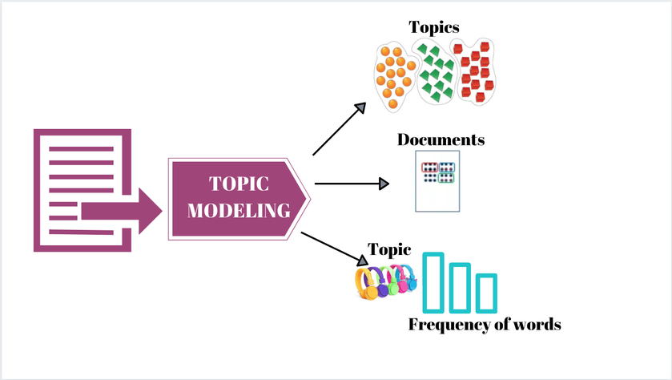
Methodology: Latent Dirichlet Allocation (LDA)
Unsupervised learning that views titles as bags of words
Key assumption: the text was generated from a set of topics and each topic was generated by picking a set of words

Slide 6
Methodology: Latent Dirichlet Allocation (LDA)
Suppose we have k topics across all of the responses text in our data
Each word is randomly assigned to a topic so that k topics are distributed across responses
Assume that each word in the responses is assigned to the wrong topic but all other words have the correct topic assignment
Two probabilities P(word|topics) and P(topics|responses) are calculated to assign word to a topic
Repeat until convergence

Slide 7
Methodology: LDA Mallet
Mallet is an open-source toolkit developed by Andrew McCullum which provides us the Mallet Topic Modelling toolkit which includes efficient and sampling-based implementation of LDA as well as Hierarchical LDA.

Slide 8
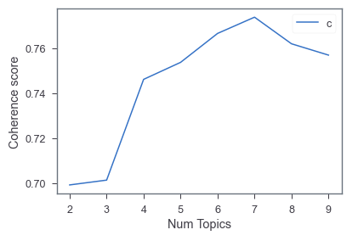
LDA Results and Evaluation
Coherence score was used to decide interpretability and the quality of learned topics.
We will choose 4 the number of topics.

Slide 9
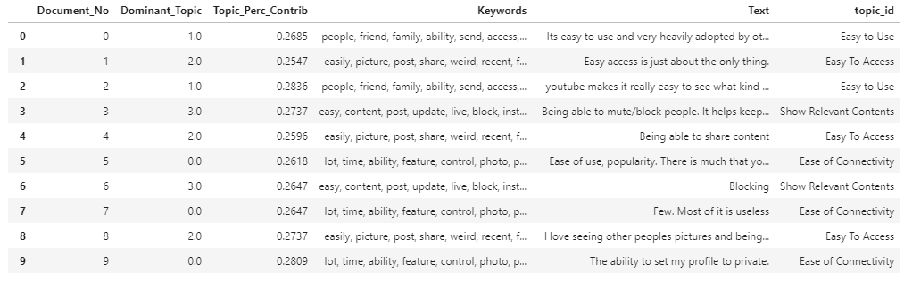
LDA Results and Evaluation
We then defined the name of our learn topic and find the dominant topic in each response

Slide 10
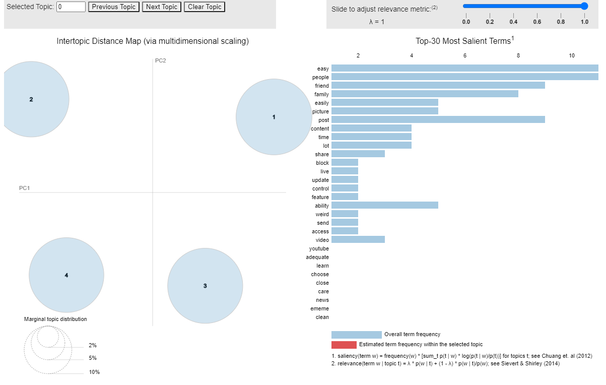
LDA Results and Evaluation
Easy to use
Ease of Connectivity
Show Relevant Contents
Easy to access

Slide 11
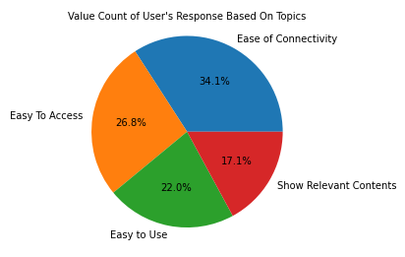
Analysis

Slide 12
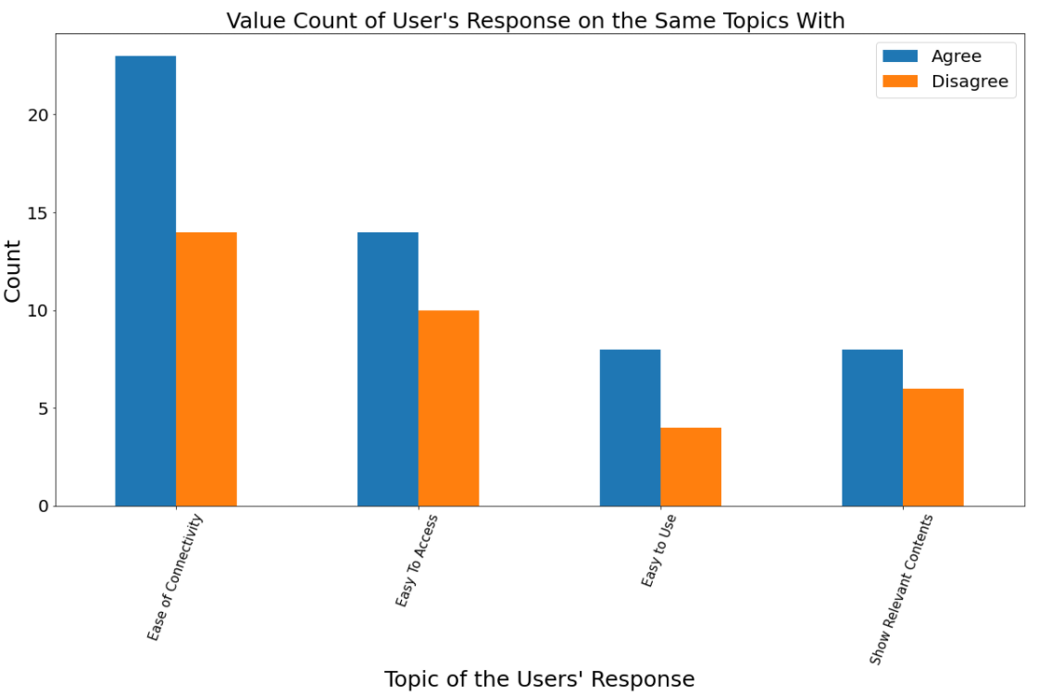
Analysis

Slide 13
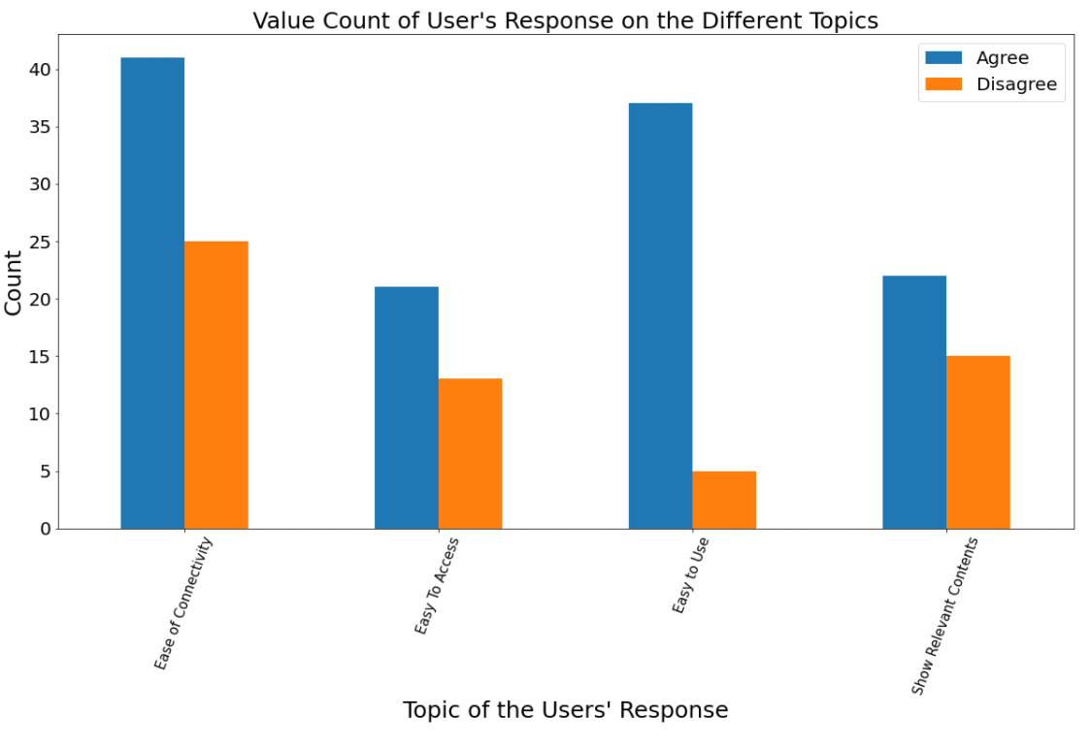
Analysis

Slide 14
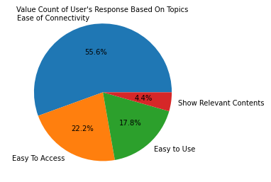
Analysis

Slide 15
Limitations and Future Work
Limitations:
It’s hard to validate and the way we name the topics can be bias and subjective!!!
Used Collapsed Gibbs Sampling -> the initial values of the variables are determined randomly -> get over this by set random_seed to the model so that the code can be reproducible.
Future Work/Improvement
External Data…?
It can be applied later if we need to perform any classification tasks.
Tune the model more.
Try different algorithms in Topic Modeling

Slide 16

Thank you!!!

